Slide 1

INTERNET AND EMAIL

Slide 2



Topic Outline
Introduction
Description Of the Internet
Historical Development of the internet
Importance of the internet
Internet connectivity requirement
Internet Services
Accessing the internet

Slide 3

First Lesson
We will cover these skills:
Define Internet
Explain the development of internet
Explain the importance of internet

Slide 4

Introduction
In the today’s society, more efficient modes of communication based on electronic tolls, Mobile phones an the internet have become standard, unlike many years ago, where ordinary means like mails and post office were used

Slide 5
Description Of Internet
In an office setup, computers can be connected with each other to enable communication between them. Transmission media such as cables are used.
Internet: is the global interconnection of computer networks for the purpose of communication and resource sharing.

Slide 6

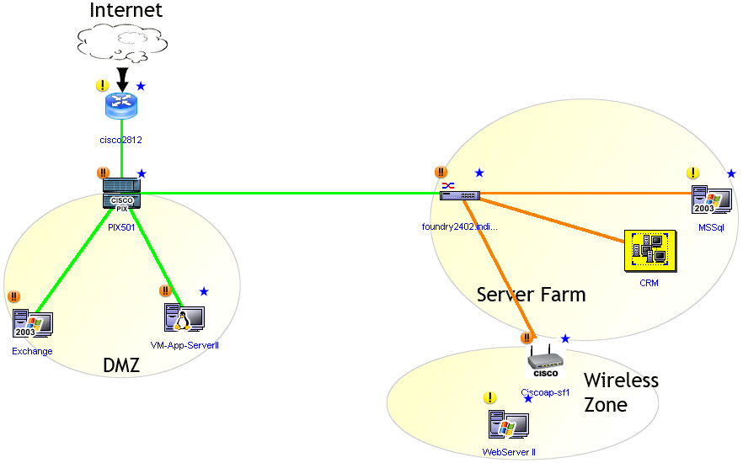
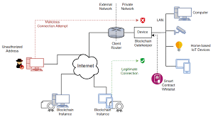
Logical view of the Internet

Slide 7
Importance of the Internet
Other importance include;
🌍 1. Communication
Email, messaging apps, video calls (e.g., Zoom, WhatsApp, Gmail) allow instant communication globally.
Keeps people connected personally and professionally.
📚 2. Access to Information and Education
Provides quick access to knowledge through websites like Google, Wikipedia, and online libraries.
Enables online learning through platforms like Coursera, Khan Academy, and YouTube.
💼 3. Business and Employment
Allows companies to market and sell products online (e-commerce).
Supports remote work and freelancing, creating job opportunities worldwide.
🛒 4. Shopping and Services
Supports E- commerce or online shopping (e.g., Amazon, Jumia) and booking services (e.g., flights, hotels, taxis).
7

Slide 8
Importance of the Internet
Internet plays a very important role in all aspects of life which leads to emergence of a global society called the information society. The importance is seen through its contribution to research, news and information dissemination, leisure and communication and business platforms.
Some benefits include;
1. It provides large range of information that can be accessed through the websites and search engines.
2. Provides many platforms such as social media through which people can easily connect to each other.
3. Provides Platforms for conduction business and marketing.
8

Slide 9
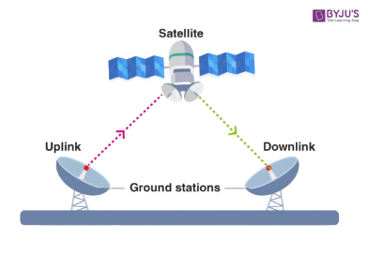
Internet Connectivity Requirements
This section seeks to discuss hardware and software resources is required to establish and access the internet.
1. Data terminal Equipment( DTE)
Are devices used to process, host and transmit data on a network. Examples are computer, mobile phones and tablets.
2. Transmission media
Physical or wireless channels used to transmit data and information from one point to another. Includes copper cables, radio waves, microwaves and satellites.
3. Satellite transmission.
Suitable for intercontinental transmission of data . The satellite sends signal to the base station on another continent where it is received and sent to the destination computer.
9

Slide 10
Internet Connectivity Requirements
4. Internet Service Providers (ISP’s)
A company that provides access to the internet and related services
The most popular internet service providers in kenya are Safaricom, Telkom, Airtel, Faiba Internet, Kenya web limited etc
5. Software
To access internet services, a computer must be installed with an internet protocol, a browser and e-mail client
10

Slide 11
Internet Connectivity Requirements
SOFTWARE
Protocols
Is a set of rules that governs how two networked devices can send and receive data on the network.
Includes Transmission control protocol (TCP) and Internet protocol (IP)
TCP- determines how data is transmitted from one device
(source) to another (destination)
IP- gives each device connected to the internet a unique identifier or a logical adres
11

Slide 12
Internet Connectivity Requirements
SOFTWARE
b) Web browsers
A browser is an application that lets the user surf or browse the internet,
Some examples of browsers includes, Microsoft edge, Mozilla Firefox, Chrome and Opera Mini
12

Slide 13
Internet Connectivity Requirements
SOFTWARE
c) E- mail client
A communication software that enables the user to receive, compose and send e-mails
Examples of e-mail clients include;
Yahoo mail
Gmail
Mozilla Thunderbird
Microsoft Outlook Google
Eudora
13

Slide 14
Internet Services
In this section, we discuss some of the services available on the internet . These include world wide web, social media, email , instant messaging, e-commerce, newsgroups, search engine and entertainment
14

Slide 15
Internet Services
World Wide Web (www)
www can be viewed as a virtual storage on the internet where information is made available for access. This information is made available through platform like;
Website – a Group of related webpages or other resources located on a webserver.
Web Portals- specialized websites that offer restricted services such as e- leaning, e-mail, searching
Blog- a website that contains personal information which can easily be updated. Can act as a diary, that may be used for business, advocacy and campaign purposes.
Multimedia – a site that contain photos, movies, music , internet , audio, mostly meant for entertainment.
15

Slide 16
Internet Services
- Documents accessible on the internet are prepared using a standard method, this methods uses a special language such as Hypertext Markup Language ( HTML) to develop web documents called webpages.
To access the information on website, you type that site’s, Uniform Resource Locator ( URL), simply known as the web address
16

Slide 17
Internet Services
Social Media And Networks
These are web based sites that allows people with common interests to share interests, activities and multimedia content. They can therefore share media content like text messages, photos , video and slide shows on social networks. Examples include, Facebook, WhatsApp, Google+ , TikTok, YouTube.
17

Slide 18
Internet Services
Electronic mail and fax
An Electronic mail refers to an e-mail message that is transmitted electronically over the internet.
An email account is needed for this.
You can also use your computer to receive and send fax messages instead of using ordinary fax machine.
18

Slide 19
Internet Services
Electronic Commerce ( E-commerce)
Good and services are being sold and bought using the internet, this is called e-commerce
The advantage of this is that the company can access customers allover the world
Also reduces operating costs but increase the sales
The challenge is there is increase in cyber crimes and theft, since people deal with each other without physically meeting
19

Slide 20
Internet Services
Electronic learning
Here, learning materials and lectures are made available online over the internet,
Examples of Platforms that provide e-learning are, Blackboard, and Module
20

Slide 21
Internet Services
Search engines
Search engines are specialized web based applications that help the user search specific information on the internet, they include, Google, Bing, Alta Vista
21

Slide 22
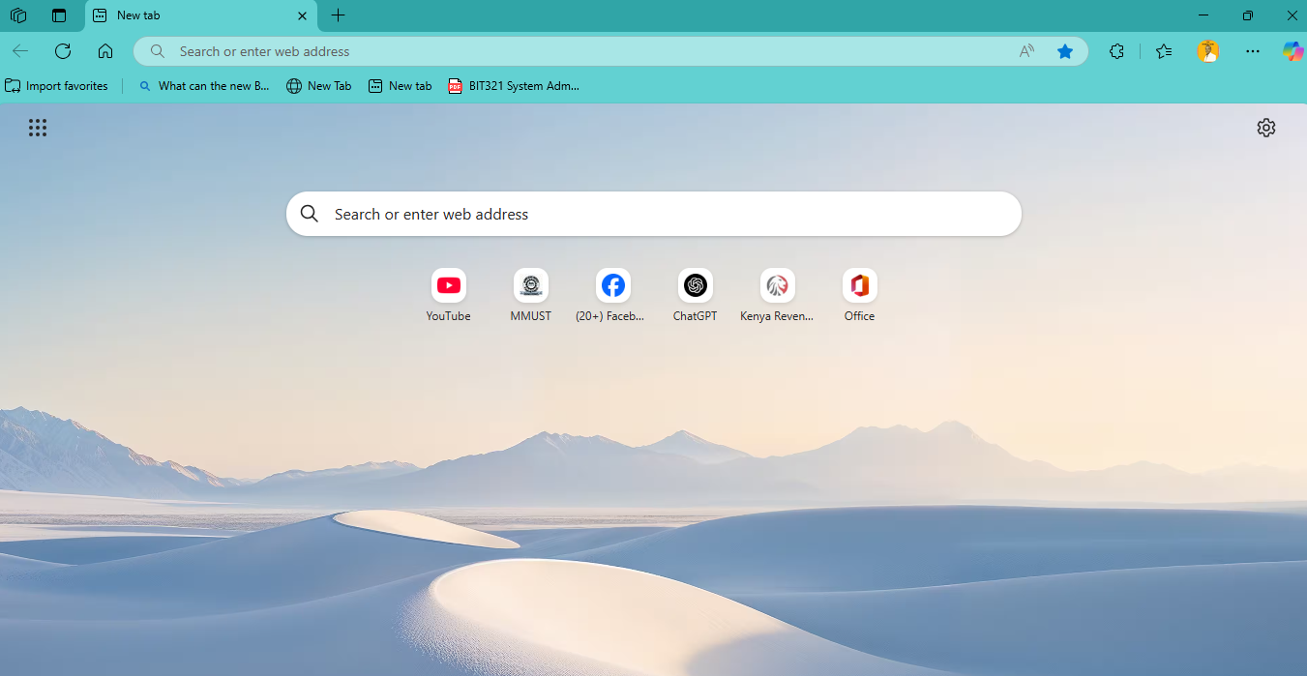
Accessing Internet Services
Browsing the web
Web browsing also called surfing; is to navigate from one website to another
22

Slide 23
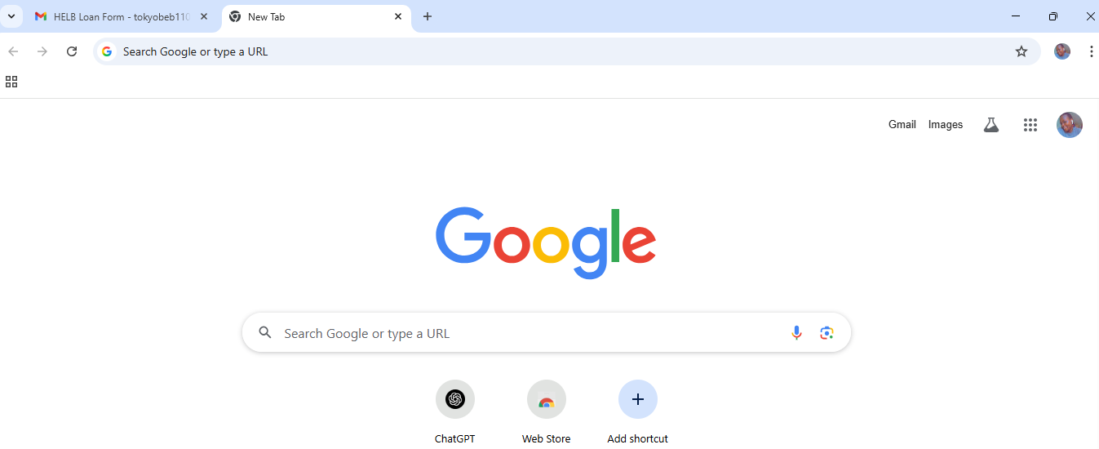
Accessing Internet Services
1. Uniform resource Locator (URL)
URL simply refers a web address that connects a user to a particular website.
The URL has two basic components namely; the protocol and domain name
2. Hyperlinks
Simply refers to as links, are special text or graphics used to navigate from one page to another, mostly appears in blue underlined text.
3. Navigation Toolbar
Contains buttons you can easily use to navigate through the browser
23

Slide 24
Accessing Internet Services
1. Uniform resource Locator (URL)
URL simply refers a web address that connects a user to a particular website.
The URL has two basic components namely; the protocol and domain name
2. Hyperlinks
Simply refers to as links, are special text or graphics used to navigate from one page to another, mostly appears in blue underlined text.
3. Navigation Toolbar
Contains buttons you can easily use to navigate through the browser
24

Slide 25
USING ELECTRONIC MAIL (E-mail)
E-mail programs like Gmail, Yahoo Mail, Ms. outlook 2013 are used to compose, receive and send emails.
Checking for mails in Gmail
To use Gmail, first sign up for an account. Google assigns each user a unique username referred to as an ID and a password.
25

Slide 26
USING ELECTRONIC MAIL (E-mail)
Opening an e-mail in Gmail
Open your browser (Chrome, Edge, Firefox, etc.)
Go to: https://mail.google.com
To Sign in using your ID password;
Enter your Gmail address (e.g., yourname@gmail.com)
Click Next
Enter your password
Click Next/Sign in
26

Slide 27
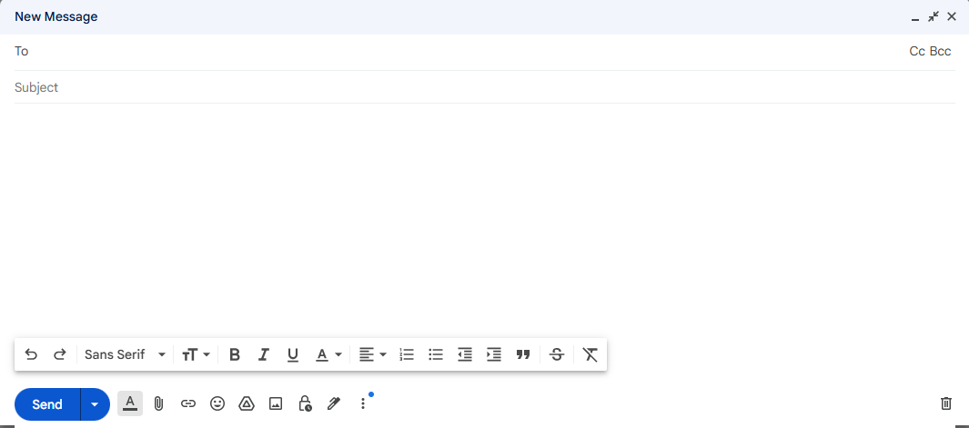
USING ELECTRONIC MAIL (E-mail)
Composing e-mails
Composing is the process of creating an email by specifying the recipient and content of including attachments. E-mail compose window has three basic elements; header, message body and Signature
27

Slide 28
USING ELECTRONIC MAIL (E-mail)
Basic Elements of e-mail compose window
Header- made up of ;
Address of the recipients – the email recipients can be more that one
Subject – Presents the topic of the message
Attachment – files attached from other programs such as word processors and spreadsheets.
2. Message body – this is the content of the email that may include text, audio or video graphics
3. Signature – provides additional sender information such as full name and telephone number
28

Slide 29

USING ELECTRONIC MAIL (E-mail)
E-mail address format
The email address determines the destination of the sent e-mail. An email address like example@gmail.com has aba specific format consisting of the username separated from the domain name by the symbol [ @ ]
1. $example$ is the username, usually decided by the user during registration.
2. @ is the symbol for “at“ , separates username from domain name in this case gmail.com
3. $gmail.com$ is the domain name for the host computer on the internet on which the account is hosted
4. The period “. “ is read as dot, separates domain name from top level domain such as com
5. Com is an acronym for commercial that identifies gmail as an organization offering commercial services.
29

Slide 30
USING ELECTRONIC MAIL (E-mail)
Other commonly used top level domains
Domain | Type | Example
.edu | Educational Institution
.gov | Government Institution
.org | Non- profit making Organization
.mil | Military Organization
.co | Commercial institution
.net
.ac
30

